Slide 1

Sentiment Analysis of Social Media Posts on AI and LLM Topics

Slide 2
In the following pages, we reflect the results of a sentiment analysis of social media posts on AI, LLM models, and related subjects. This analysis was adapted from the Kaggle notebook “Sentiment Analysis of tweets” and the LinkedIn learning course “Text analytics” by Kumaran Ponnambalam. We used libraries such as tweepy, nltk, matplotlib, pyplot, wordcloud, and Textblob for data collection, processing, analysis, and visualization. The main steps of the analysis were:
We collected approximately 45,000 posts over a period of one week from social media.
We applied TextBlob to classify the posts into positive, negative, and neutral sentiments.
We analysed the sentiment distribution and identified the main topics and patterns of discussion.
The purpose of this analysis is to understand the sentiment and public perception of AI and LLMs models among social media users and inform future research and development.

Slide 3
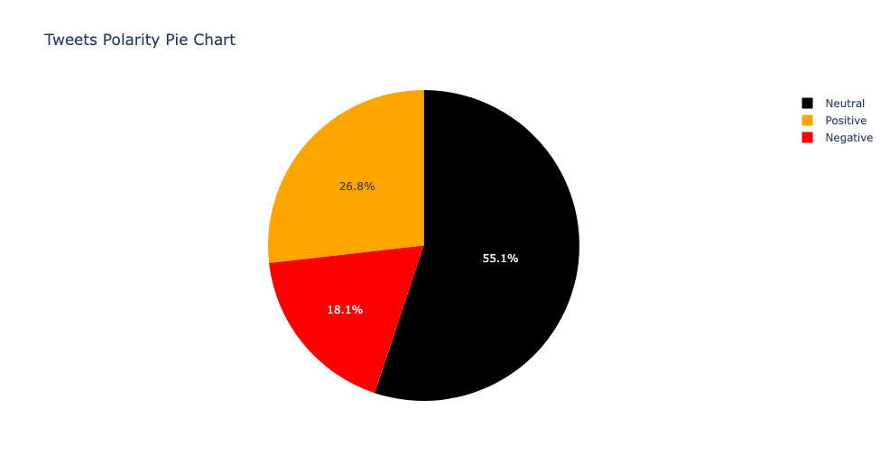
Polarity is a measure of how positive or negative a text is, ranging from -1 to 1. Sentiment is a label that indicates whether a text is positive, negative, or neutral.
Almost half of the posts (about 55%) have a neutral sentiment, meaning they do not express a clear opinion or emotion about AI and LLMs. About 27% of the posts have a positive sentiment, indicating that they favour AI and LLM. Only 18% of the posts have negative sentiments, suggesting they are critical or sceptical of AI and LLM.
The average polarity of the posts is 0.03, which is slightly positive. This means that the overall tone of the social media discourse on AI and LLM is somewhat polarized and moderate but balanced and moderate.
Polarity and Sentiment Distribution of Social Media Posts

Slide 4
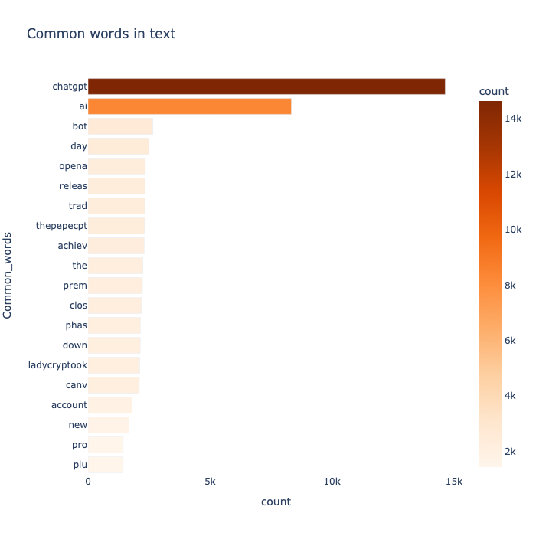
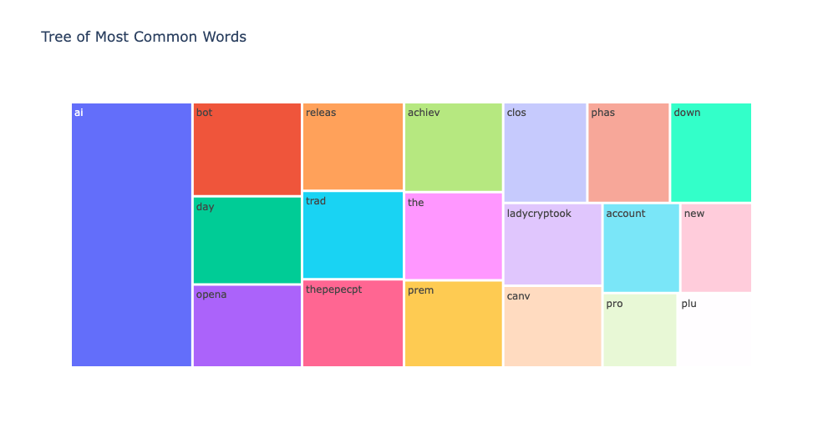
Key Insights and Relevant Terms Analysis
The list of most used words extracted from the analysis reveals several relevant terms. The presence of ChatGPT suggests a focus on chatbot interactions and natural language processing. It is expected to see mentions of AI bot and AI due to its central role in the analysis. Additionally, the inclusion of OpenAI highlights the prominence of this organization in the field of AI. The appearance of terms such as NFTs, ladycryptook, and thepepecpt related to the blockchain domain, underscores the relevance and influence of the intersection between these emerging technologies and the sentiment expressed regarding their potential impact on AI or LLM. Furthermore, the presence of the word New could suggests the inclusion of recent developments or advancements, showcasing a focus on the latest trends and updates.

Slide 5
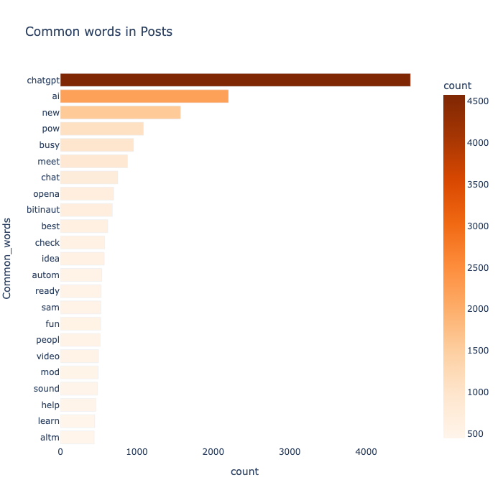
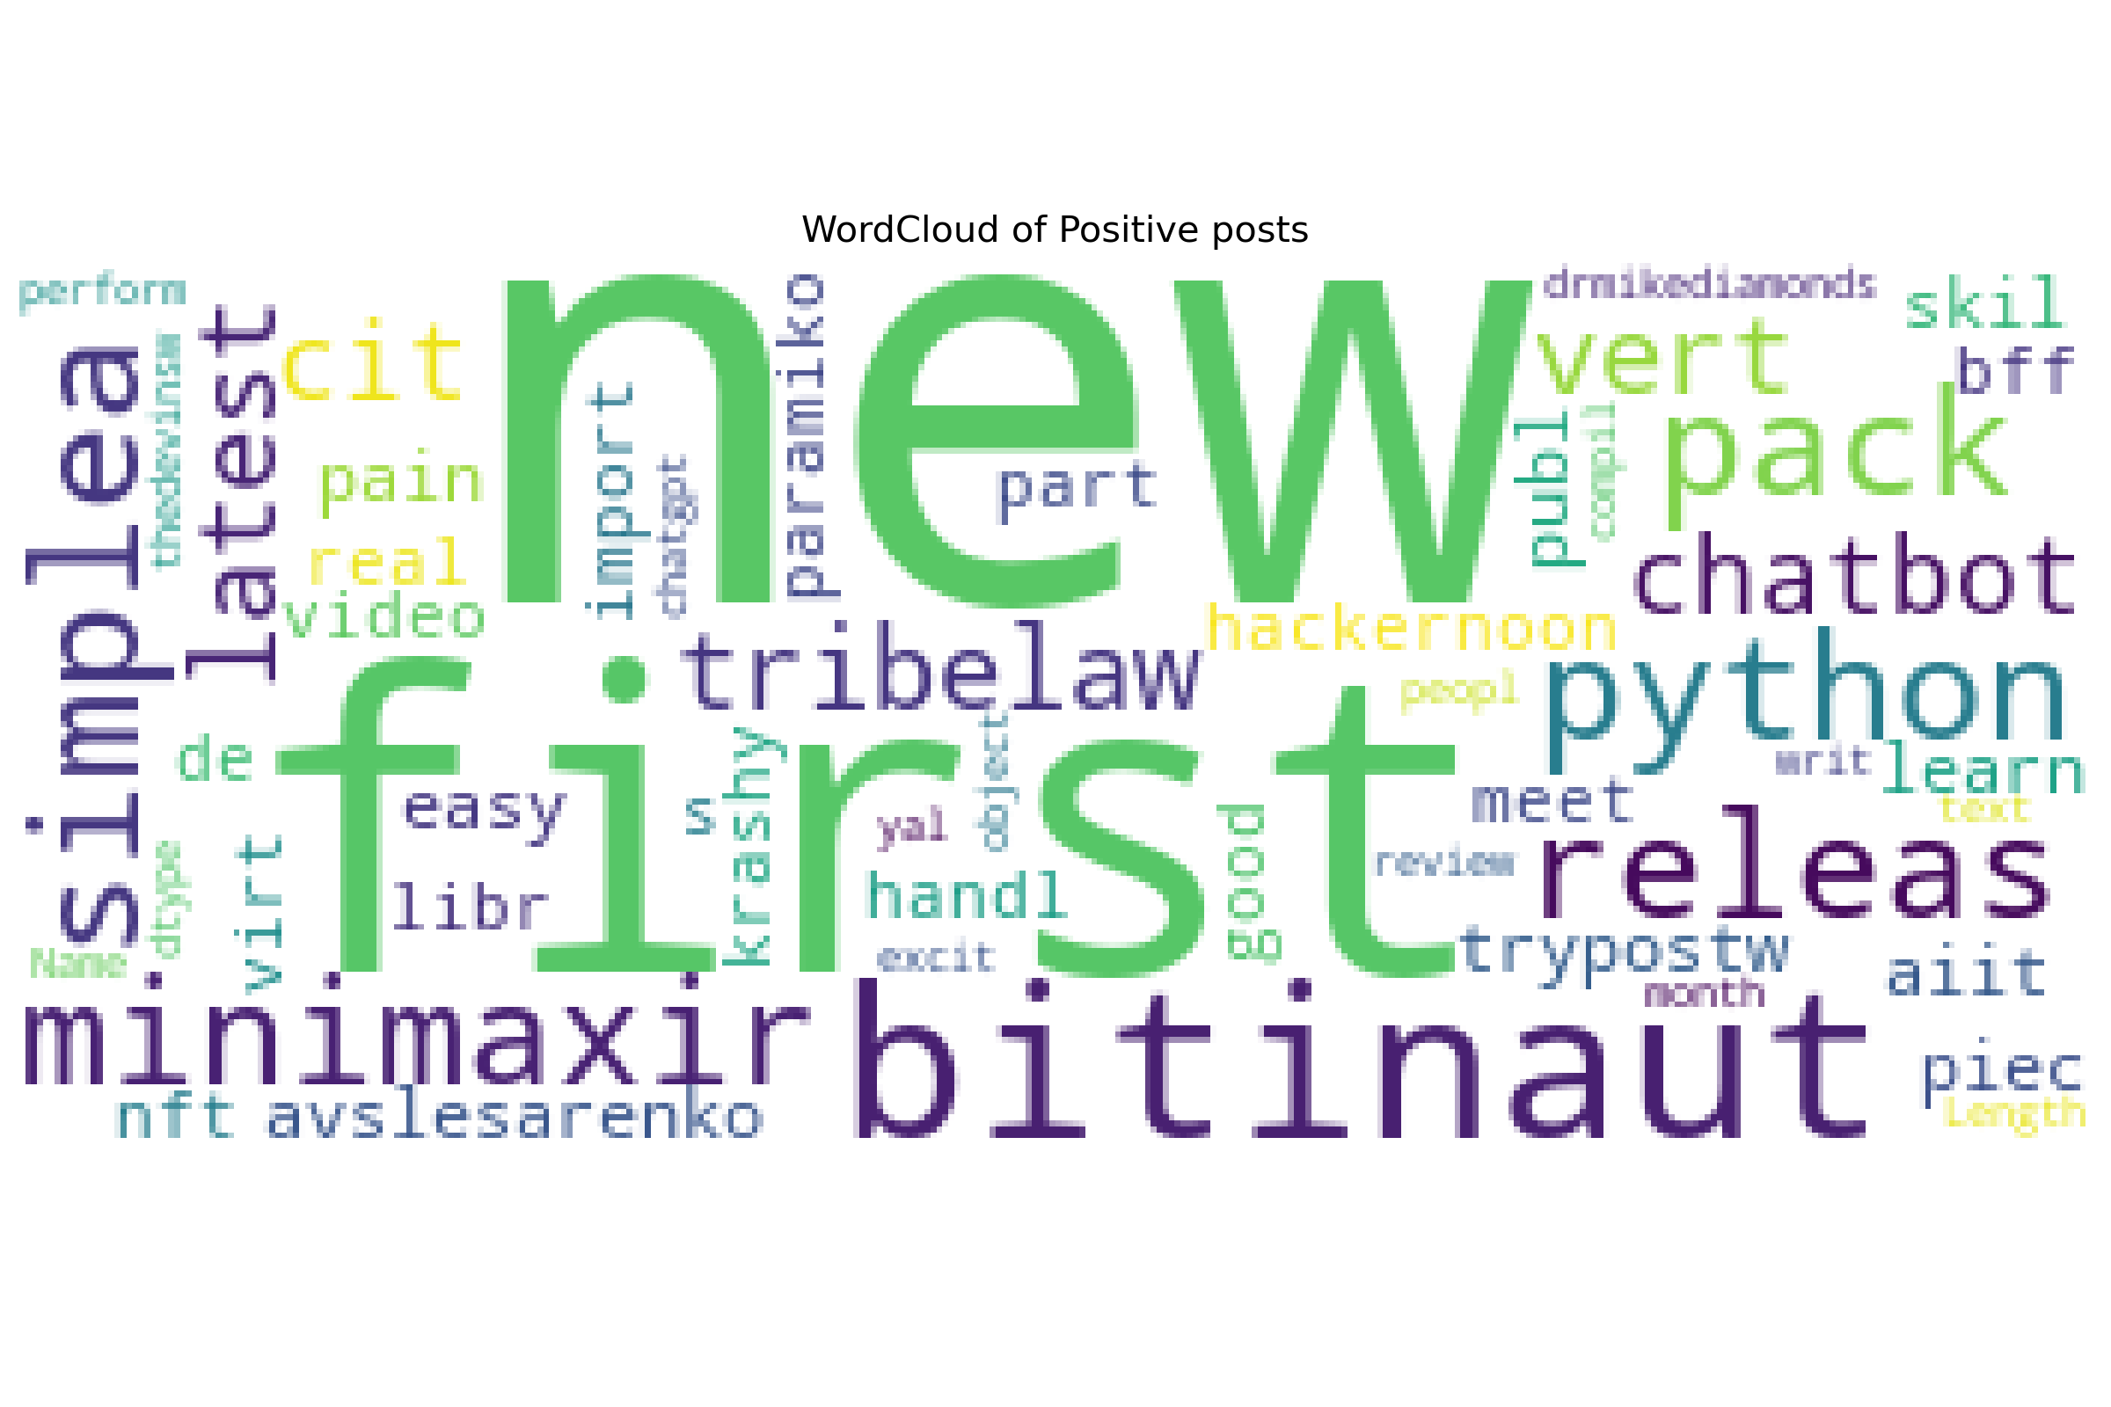
Positive Sentiment Snapshot: Key Words from Analyzed Tweets
Consistency appears in this spectrum of the analysis as expected with common words as ChatGPT and AI. The presence of terms like "new," "best," and "ready" suggesting a positive sentiment towards recent developments or advancements in AI, and "meet," "chat," and "help" indicating engagement and interaction. Pow potentially (Proof of Work), bitinaut" and "opena confirming the intersection of projects in the AI industry with those in the blockchain space.

Slide 6
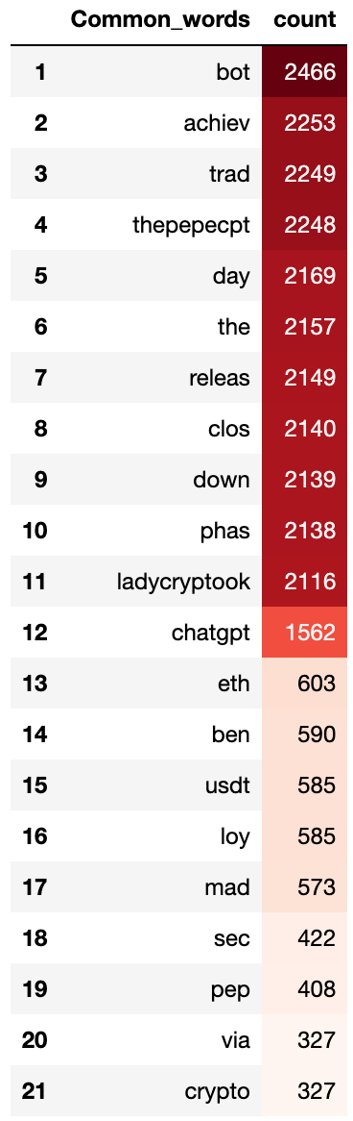
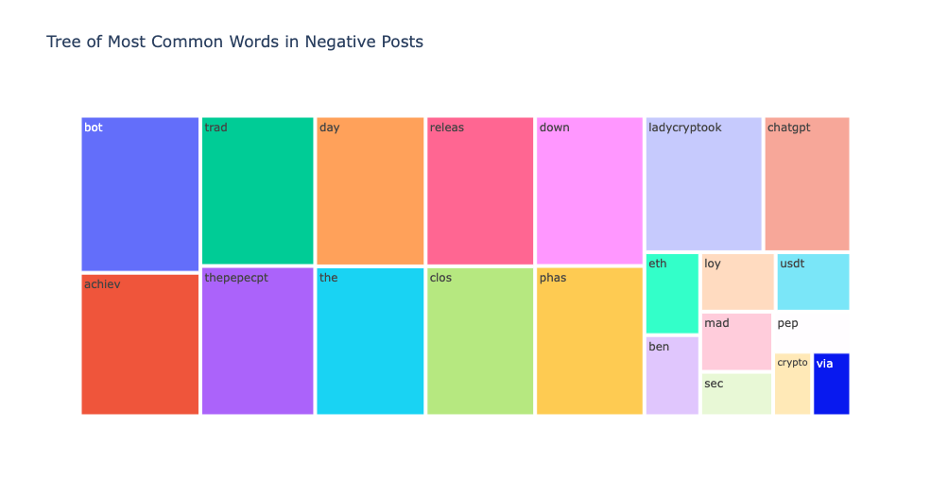
Top Words in Negative Spectrum: Insights into Sentiments and Concerns
The analysis of negative sentiment reveals a range of relevant terms. The mention of "bot" indicates a potential negative perception or experience related to chatbot interactions. Terms like "achiev," "trad," and "releas" might suggest dissatisfaction or disappointment with certain achievements, trading activities, or releases in the AI or LLM domain. The presence of "chatgpt" further highlights negative sentiments associated with AI chatbot interactions. Although "chatgpt" is not among the most frequently mentioned words in the negative spectrum. This could suggest that while there are negative sentiments expressed in relation to chatbot interactions, they may not be the predominant focus. Additionally, the appearance of terms like "eth" (referring to Ethereum), "usdt" (Tether stablecoin), and "crypto" suggests a negative sentiment towards cryptocurrency-related aspects.

Slide 7
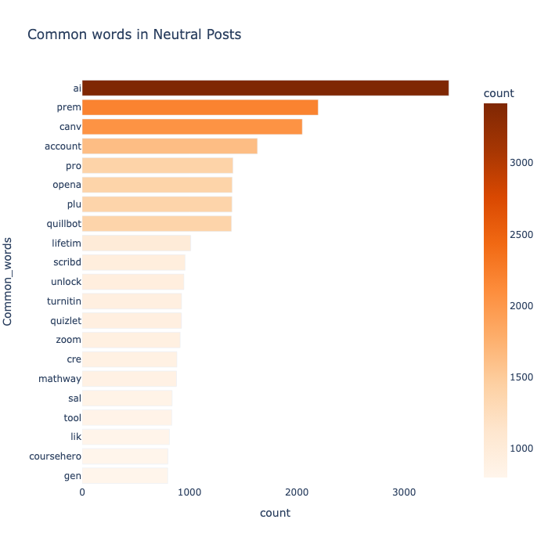
Common Words in Neutral Posts: A Balanced Perspective
"AI" is expected in this group as the central topic in the analysis. The mention of "premium" could imply discussions about premium accounts or services related to AI. Canvas, Account, Pro, Plus are terms that suggest a focus on professional accounts or upgraded features, while Quillbot, Lifetime Scribd, Unlock, Turnitin, Quizlet, alongside with Mathway, Sal (possibly referring to Sal Khan of Khan Academy) words associated with various educational tools or platforms which presence in the neutral group suggests a balanced view or discussions related to the functionality and usefulness of these tools. Finally, the mention of "Zoom" indicating discussions related to online meetings or virtual communication.
Overall, the words found in the neutral posts suggest a balanced and diverse range of topics, covering AI, educational tools, platforms, and resources.

Slide 8
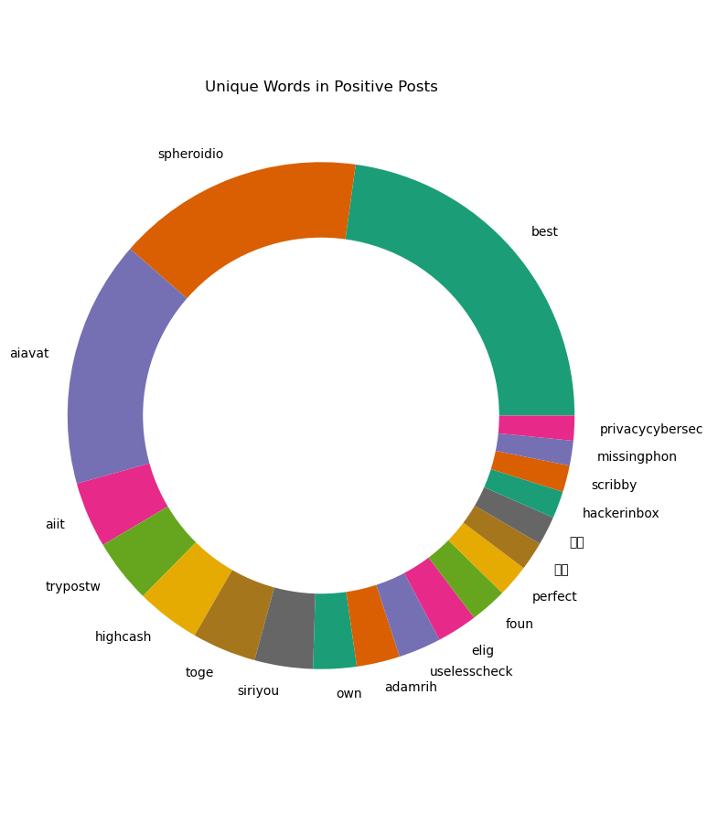
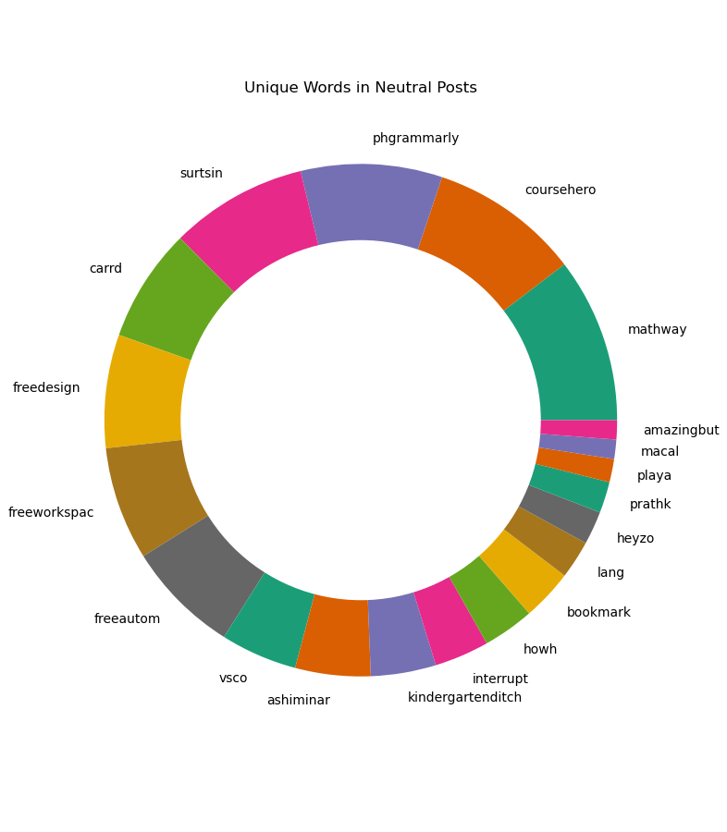
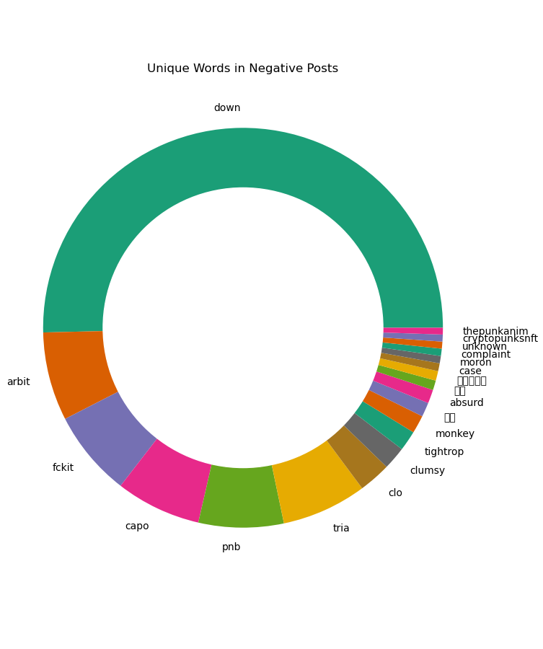
Unique Words by Sentiment: Exploring Distinctive Vocabulary
The donut charts presented here illustrate the unique words found within each sentiment category—positive, negative, and neutral. This visual representation allows us to identify words that appear exclusively in one sentiment group and do not overlap with the others.

